Slide 1
Econ 210a: Industrial Revolutions (February 12, 2020a)
J. Bradford DeLong
Spring 2019
Evans 648
W 1:10-3:00 pm
<https://bcourses.berkeley.edu/courses/1487686/>
<https://github.com/braddelong/public-files/blob/master/econ-210a-lecture-4a.pptx>

Slide 2
Industrial Revolutions: Readings for February 12…
Robert C. Allen (2011): Why the Industrial Revolution Was British: Commerce, Induced Invention and the Scientific Revolution <http://onlinelibrary.wiley.com/doi/10.1111/j.1468-0289.2010.00532.x/pdf>
Peter Temin (1997): Two Views of the British Industrial Revolution <http://www.jstor.org/stable/pdfplus/2951107.pdf>
Stephen Nicholas and Richard H. Steckel (1991): Heights and Living Standards of English Workers during the Early Years of Industrialization, 1770–1815 <http://www.jstor.org/stable/pdfplus/2123399.pdf>

Slide 3
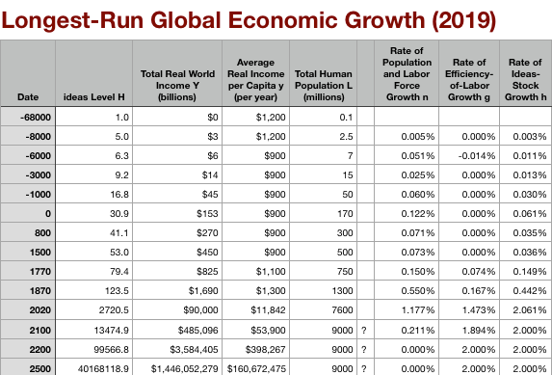

Allen’s Assertions
For ‘the west’ the largest multiplicative jump up comes with the Industrial Revolution
And Allen wants to argue that the further upward jump to MEG is then baked in the cake
Steam & iron & machine tools ⇒ inevitable development of the technologies of the “Second Industrial Revolution”: electricity, organic chemicals, internal combustion engines, advanced materials, &c….
First generation industrial-revolution technologies profitable to deploy only at the center
Second generation industrial-revolution technologies profitable to deploy in “the west”
Third generation industrial-revolution technologies profitable to deploy everywhere
But—according to Allen—no first generation profitability, no first generation industrial-revolution technologies…

Slide 4
Reading Allen
Robert C. Allen (2011): Why the Industrial Revolution Was British: Commerce, Induced Invention and the Scientific Revolution <http://onlinelibrary.wiley.com/doi/10.1111/j.1468-0289.2010.00532.x/pdf>:
Britain had a unique wage and price structure in the eighteenth century, and that structure is a key to explaining the inventions of the industrial revolution:
British wages were very high by international standards, and energy was very cheap.
This configuration led British firms to invent technologies that substituted capital and energy for labour.
And when technology was first invented, it was only profitable to use it in Britain.
High wages also increased the supply of technology by enabling British people to acquire education and training.
Britain’s wage and price structure was the result of the country’s success in international trade, and that owed much to mercantilism and imperialism.
Eventually it was improved enough that it became cost-effective abroad.
When the ‘tipping point’ occurred, foreign countries adopted the technology in its most advanced form…”

Slide 5
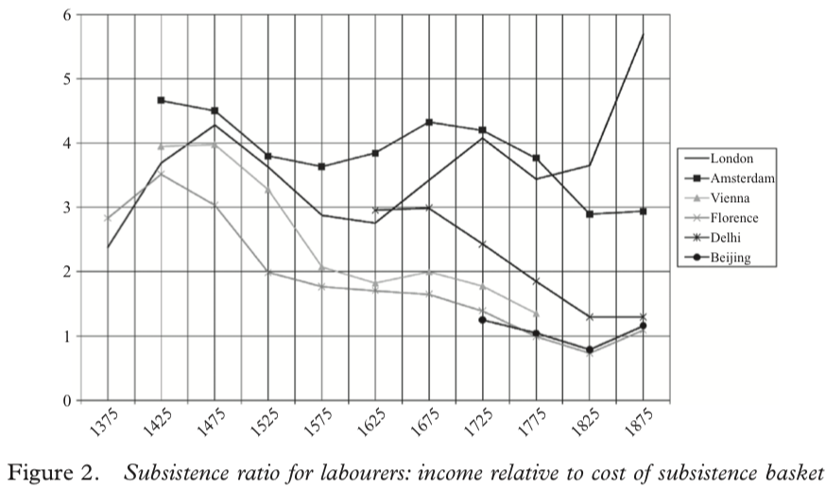
“Subsistence Basket” Wages
But this is an input rather than an output to the process of generating modern economic growth…

Slide 6
Robert Allen: Rule, Brittania!
Britain had uniquely high real wages
Why? Northwest European marriage pattern?
Why? Yeoman smallholder legacy of the Bubonic Plague?
Why? The British navy and the British empire and the fiscal-military state?

Slide 7
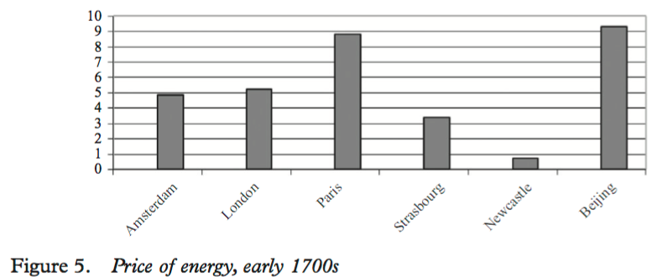
Rule, Brittania! II
Britain—not London so much as Newcastle, and Manchester—had a uniquely cheap real price of energy
Why? Coal at the surface?
Why? Coal on navigable water?
Why? Wet coal mines?
Only in Britain would the first generation of steam engines be both (a) useful and (b) profitable
Eighteenth-century Lancashire the only escape from Malthusian agrarian poverty

Slide 8



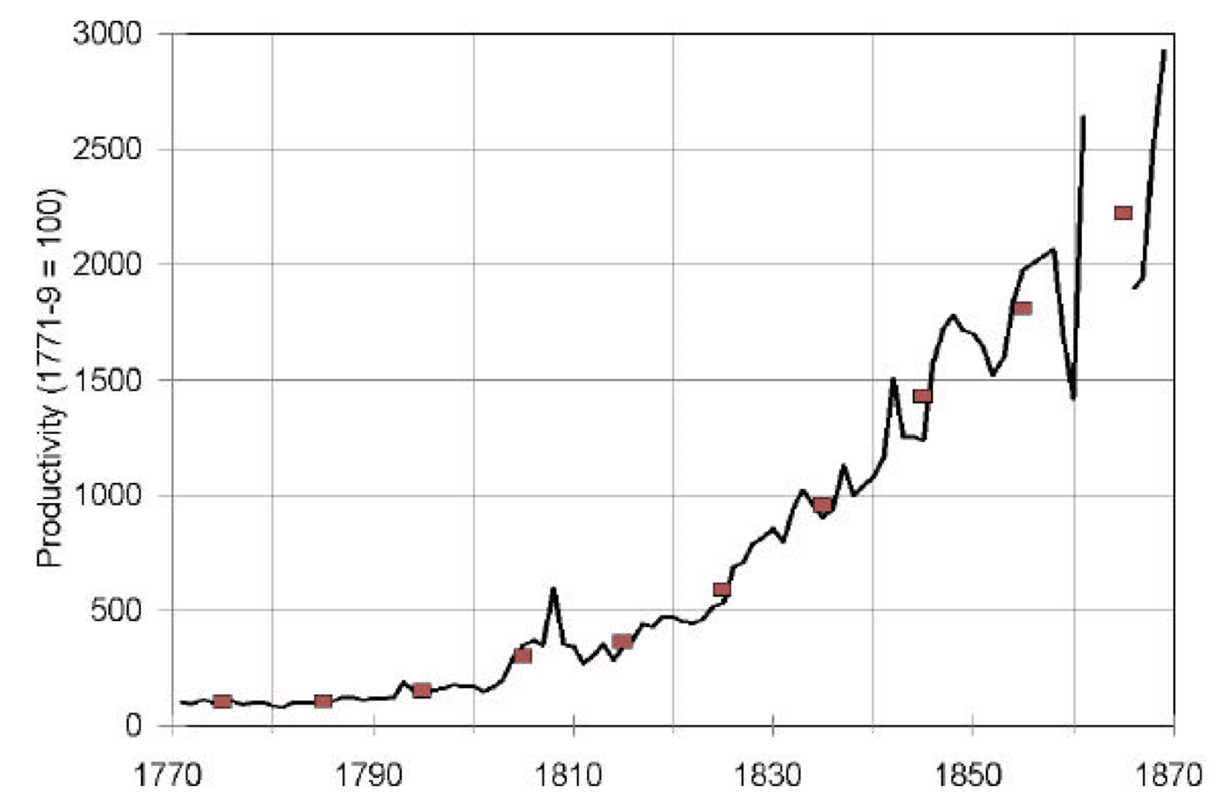
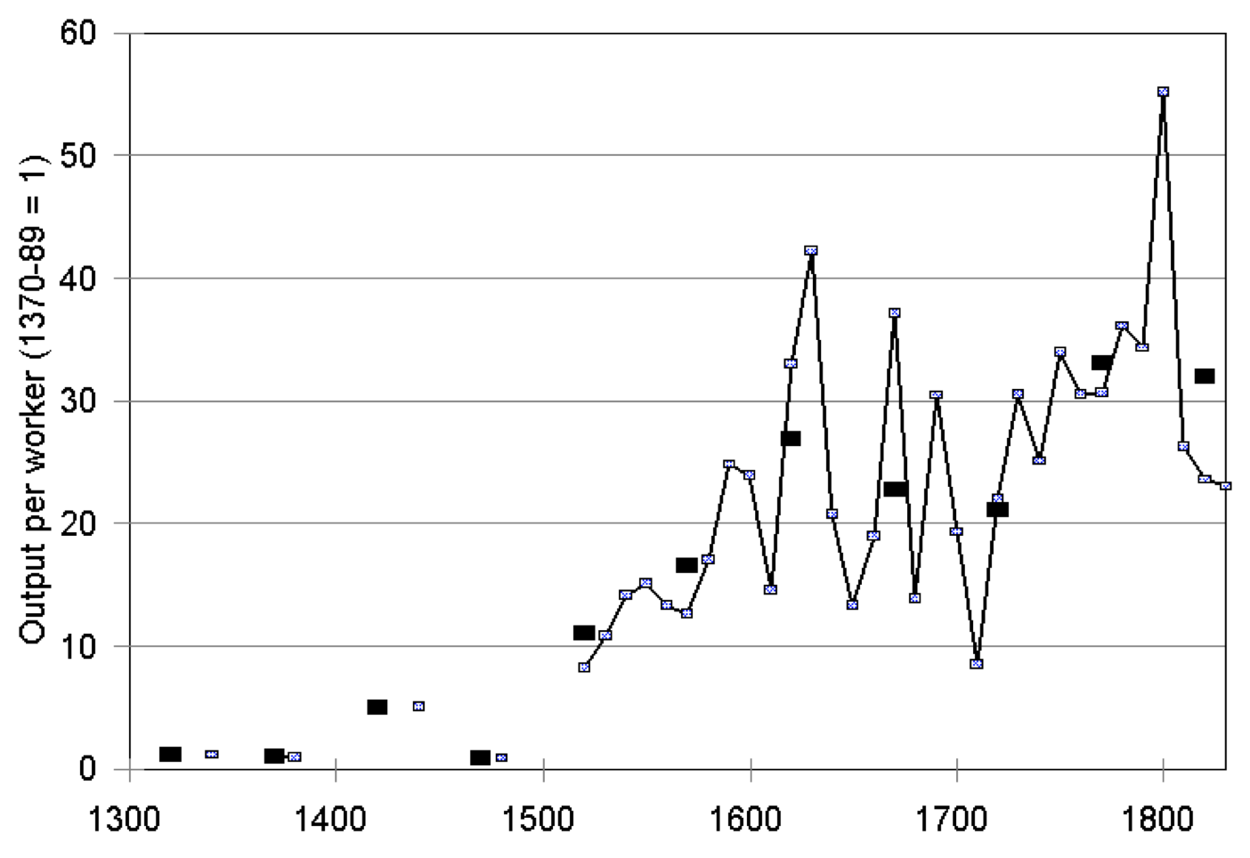
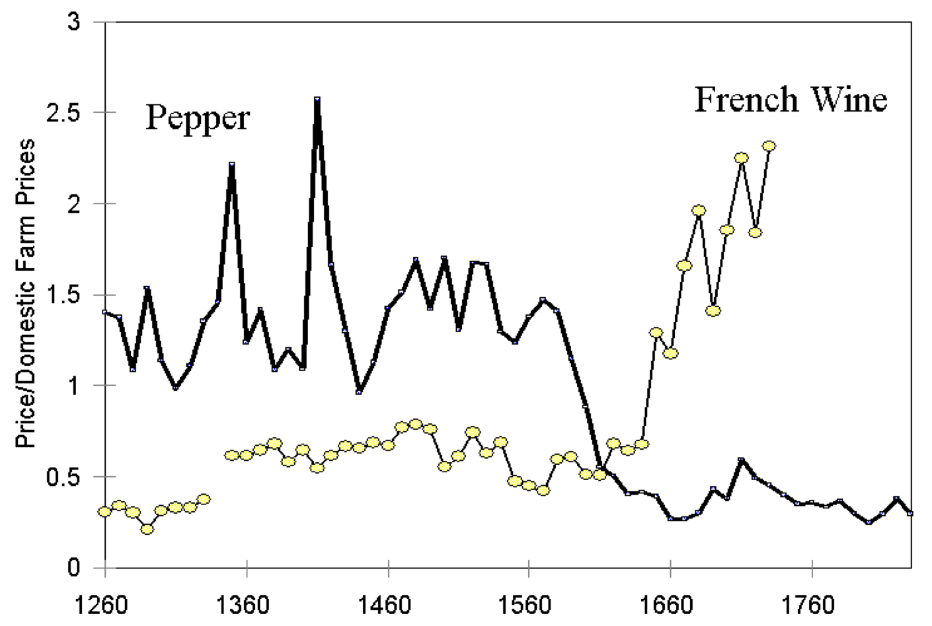
Questions About Allen
What supports are needed for the fact that a first-generation steam engine would be profitable to lead to the actual invention and then deployment of first-generation steam engines?
What supports are needed for “tinkerers” to turn first-generation into second- and third-generation steam engines?
How about textile machinery and the iron masters? Water power worked fine for them, right? How is it that they fit into this particular mix?
Could the Industrial Revolution have ground to a halt without the factor price configuration that supported steam?
What % of non-necessities consumption are pepper and wine, books, and textiles, anyway?

Slide 9
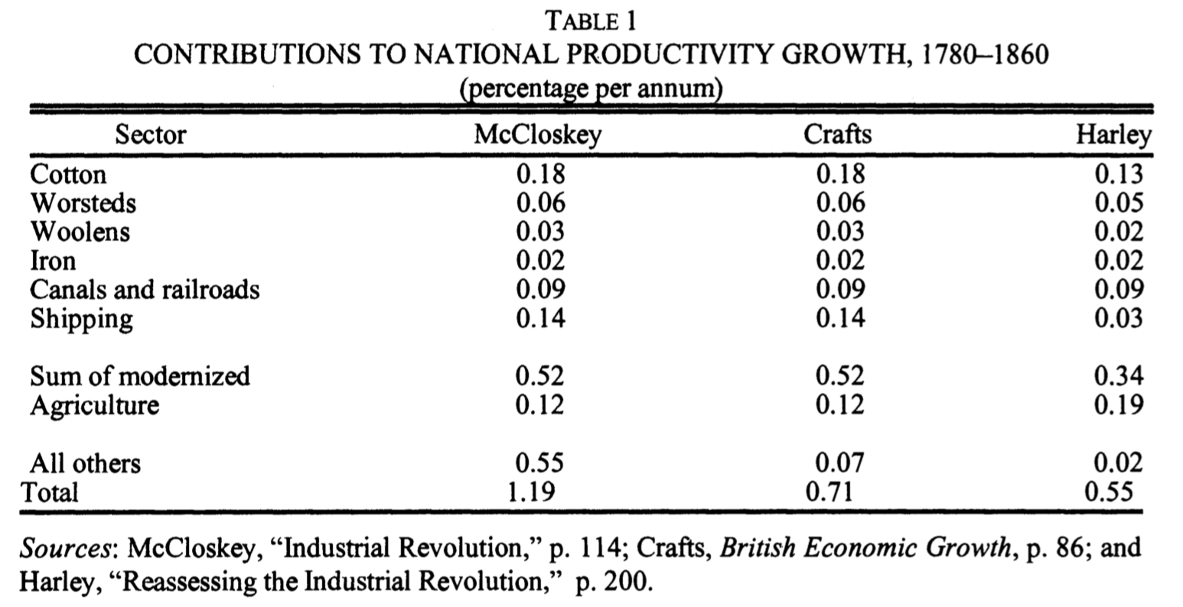
Reading Temin
Peter Temin (1997): Two Views of the British Industrial Revolution <http://www.jstor.org/stable/pdfplus/2951107.pdf>:

Slide 10
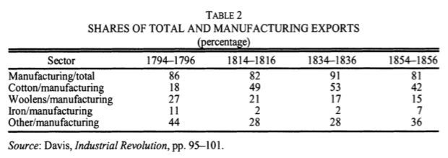
Two Views of the British Industrial Revolution
Peter Temin. 1997, “Two Views of the British Industrial Revolution,” Journal of Economic History 57 (March), pp.63–82. www.jstor.org/stable/pdfplus/2951107.pdf

Slide 11
Two Views of the British Industrial Revolution
“There was, as noted for exports in Table 4, little variation in the composition of British imports over the first half of the nineteenth century….
“Britain maintained a clear comparative advantage in a wide variety of manufacturing industries throughout the first half of the nineteenth century. They held their own in the face of the spectacular growth of cotton-textile exports during those years. There is no hint that these other commodities were being pushed off the list of exports by the growth of cotton exports….
“There is an exception that proves the rule… watches and clocks. As Landes noted in his book on that industry, the English clockmakers and watchmakers were falling behind their continental competitors in the nineteenth century. Productivity stagnated in this industry, and it had become an import industry by midcentury.
“The export of most other manufactures, however, was continuing merrily along. The lesson of the constant rank order of these exports is that the various industries were keeping pace with each other…”

Slide 12
Two Views of the British Industrial Revolution
Temin seeks to investigate whether the “narrow front“ coal and steam and textiles and iron interpretation of the British Industrial Revolution fits the historical facts better or worse than the “broad front“ innovative society and economy interpretation.
Temin aims to use the Ricardian theory of trade and revealed comparative advantage To shed insights into changes in industry-level productivity over the course of the Industrial Revolution.
He finds essentially no change in the set of commodities that Britain exports and imports across the Industrial Revolution.
He claims that this decisively answers the question in favor of the “broad front” interpretation.

Slide 13
Two Views of the British Industrial Revolution
Why might he be wrong?

Slide 14
Two Views of the British Industrial Revolution
Why might he be wrong?
Capital outflows…
Improvements abroad in agriculture etc.
Changes in relative prices…
Especially cotton...

Slide 15
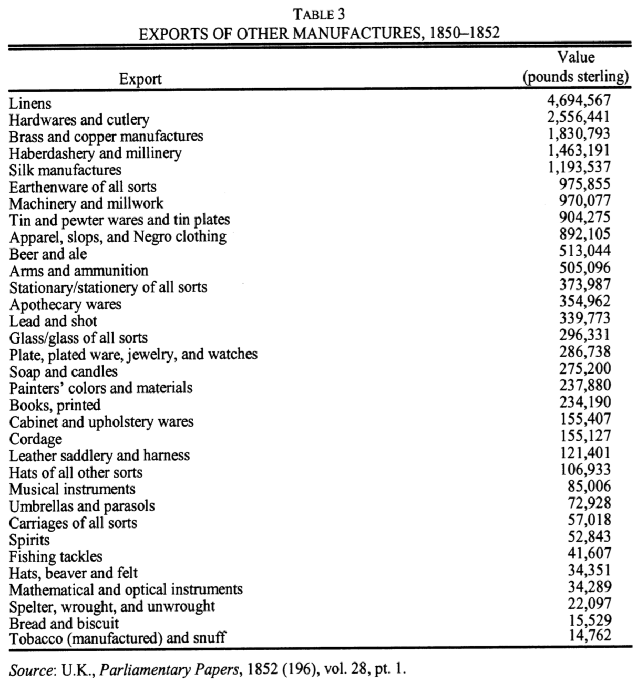
Two Views of the British Industrial Revolution

Slide 16
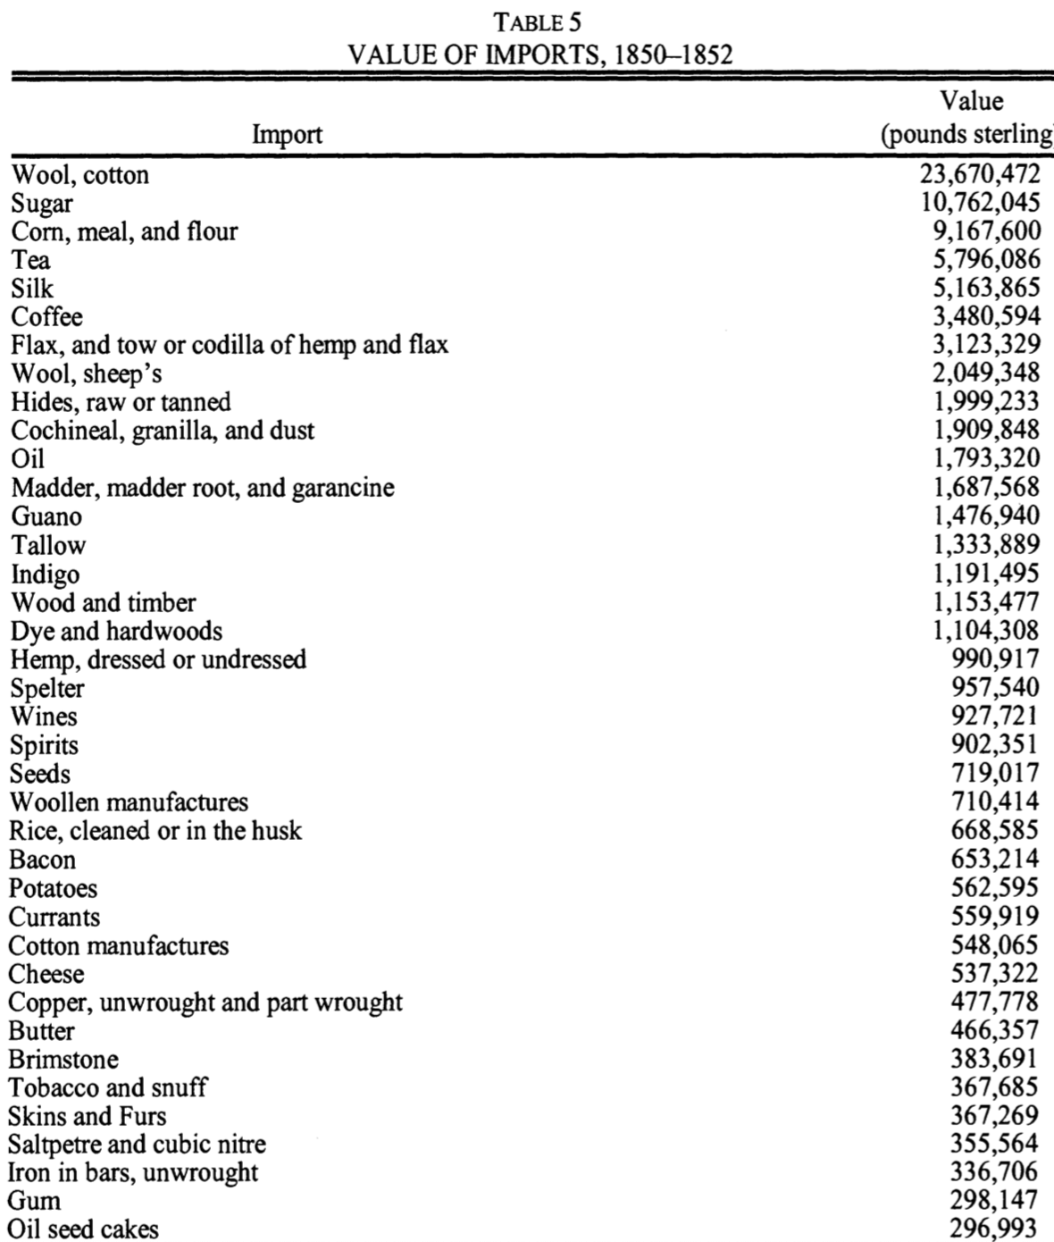
Two Views of the British Industrial Revolution

Slide 17
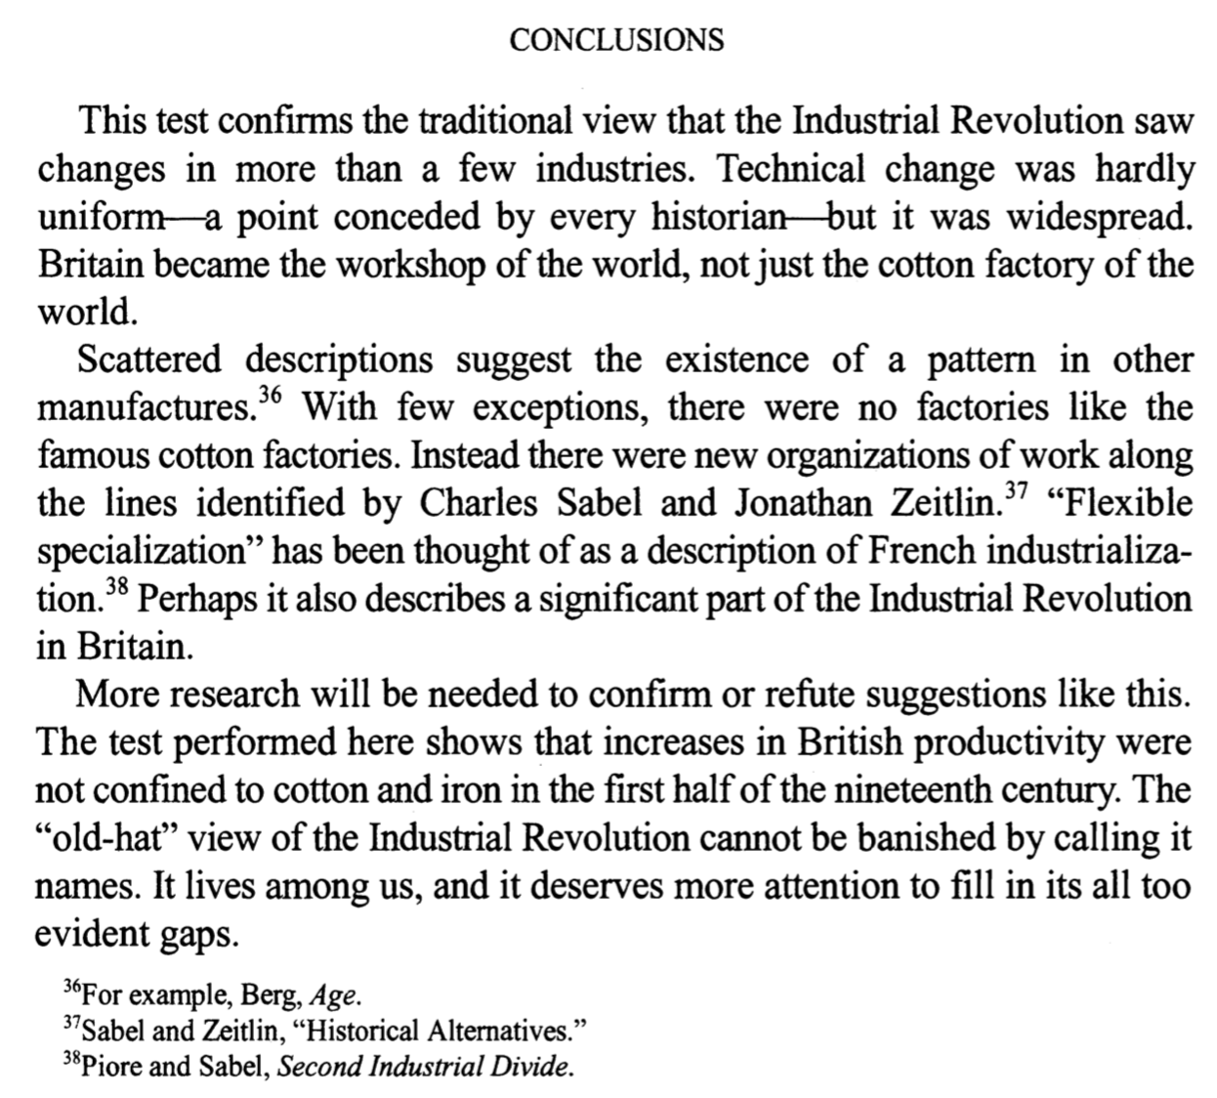
Two Views of the British Industrial Revolution

Slide 18
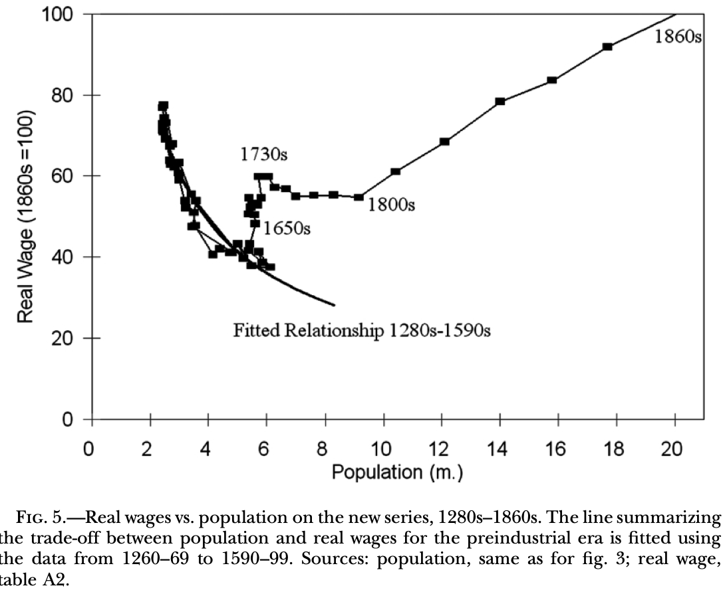
Questions About Temin
Does this paper survive the “price of textiles” critique?
Does this paper cause big problems for Allen?
What was going on before 1800 if Allen is right?
Why the timing of the acceleration if Allen is wrong?

Slide 19
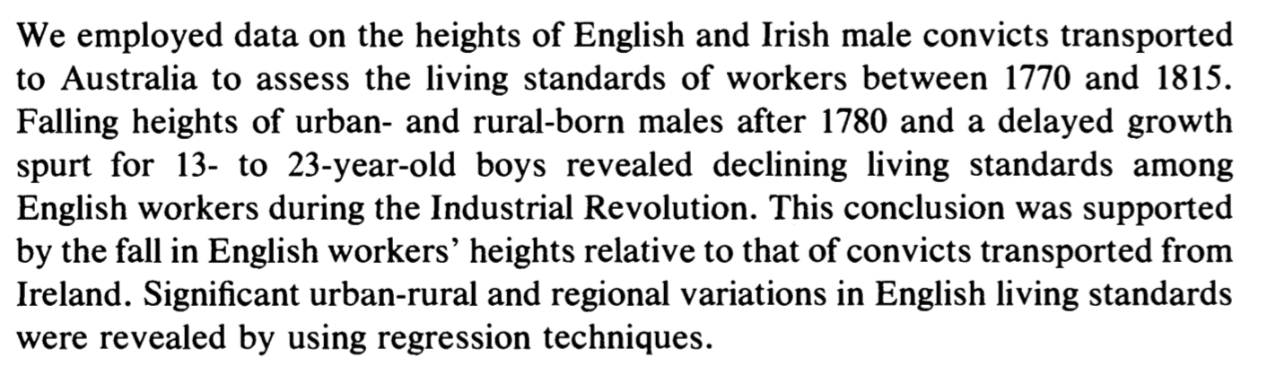
Reading Nicholas and Steckel
Stephen Nicholas and Richard H. Steckel (1991): Heights and Living Standards of English Workers during the Early Years of Industrialization, 1770–1815 <http://www.jstor.org/stable/pdfplus/2123399.pdf>:

Slide 20
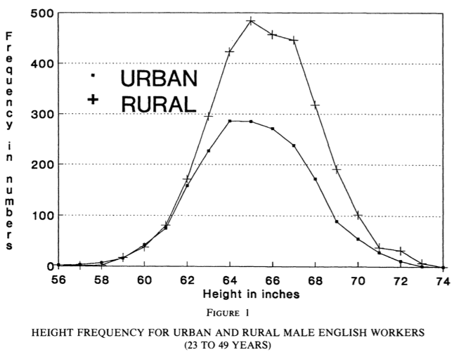
Heights and Living Standards of English Workers during the Early Years of Industrialization, 1770–1815
Stephen Nicholas and Richard H. Steckel (1991), “Heights and Living Standards of English Workers during the Early Years of Industrialization, 1770–1815,” Journal of Economic History 51 (December), pp.937–957. www.jstor.org/stable/pdfplus/2123399.pdf

Slide 21
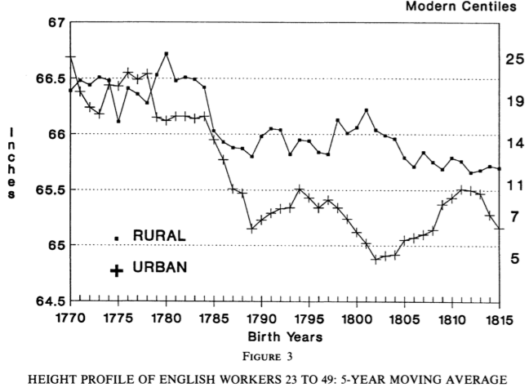
Five-Year Moving Averages
The

Slide 22
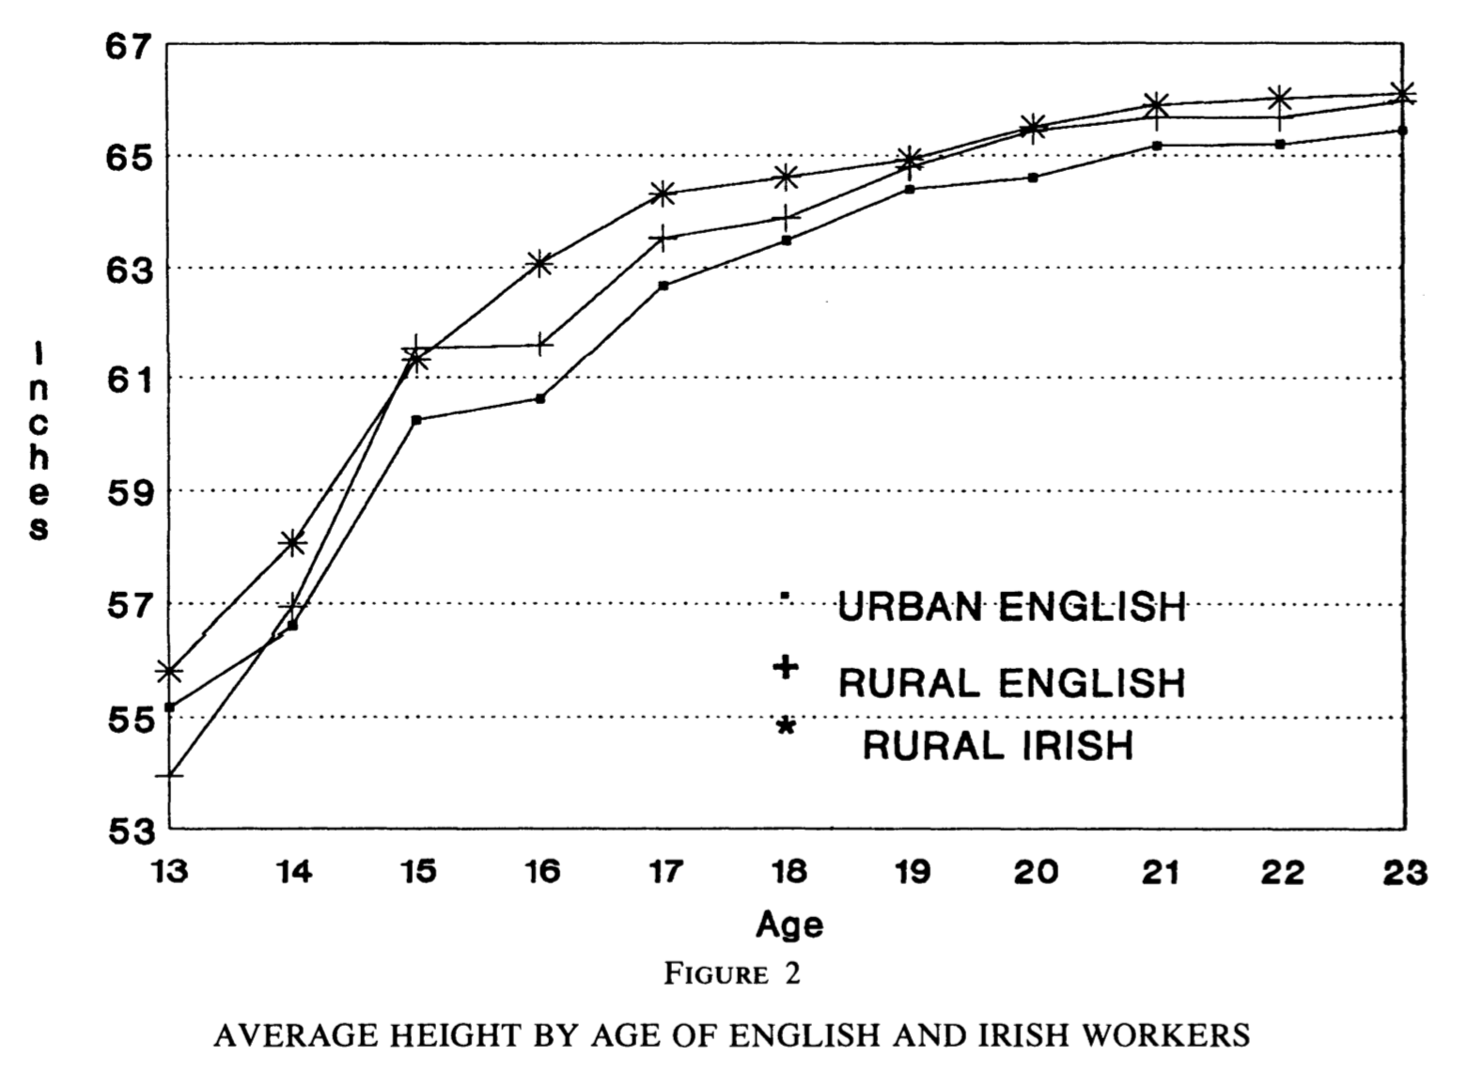
Growth Curves

Slide 23
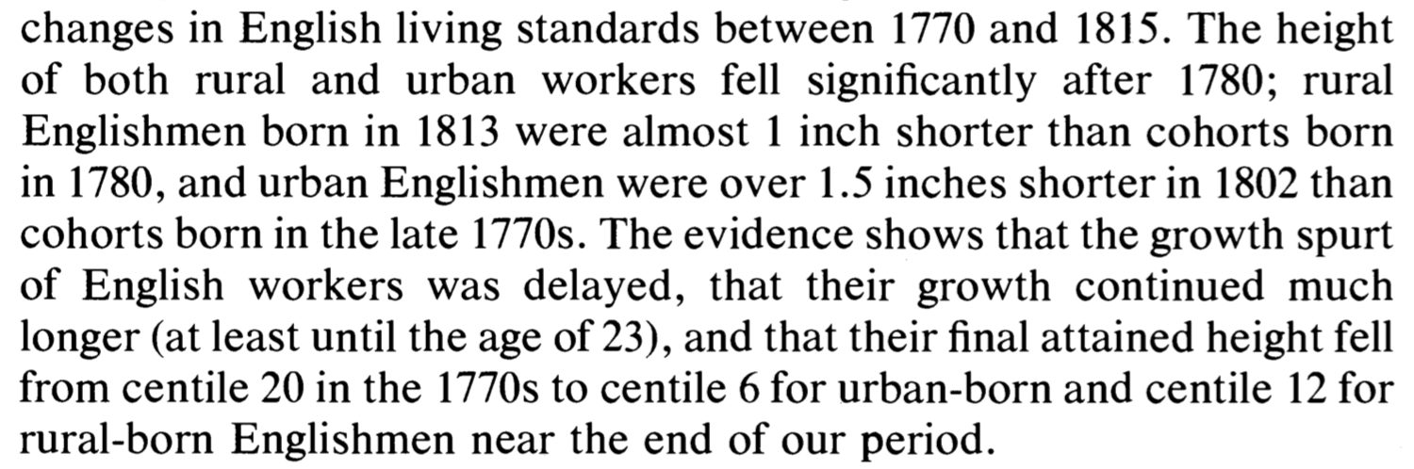
Conclusions

Slide 24
Questions About Nicholas and Steckel
Transportees. What could go wrong with using transportees?
The urban/rural divide. Is this properly assessed as standard of living or utility?
When does the height decline take place?
Why isn’t there a height rise? Things are happening in this period to real wages…
Why is the urban-rural correlation not smaller? Not bigger?
What freaky thing is going on in urban heights for those born between 1784 and 1789?

Slide 25
Lecture Next Time: Modern Economic Growth
The three key numbers in this course are: 0.15, 0.44, 2.06—the annual percentage growth rates h of the useful-ideas stock in the Commercial Revolution, Industrial Revolution, and Modern Economic Growth periods. (Or perhaps 0.2, 0.9, 2.3—the numbers for “the West”.) But is it really best thought of as 2.06 (or 2.3)? And why is it so much bigger than 0.44 (or 0.9)?:
Readings:
William D. Nordhaus (1997): Do Real-Output and Real-Wage Measures Capture Reality? The History of Lighting Suggests Not <http://www.nber.org/chapters/c6064>
Robert Gordon (2000): Interpreting the “One Big Wave” in Long-Term Productivity Growth <https://www.nber.org/papers/w7752.pdf>
Peter Thompson (2001): How Much Did the Liberty Shipbuilders Learn? New Evidence for an Old Case Study <http://www.jstor.org/stable/pdfplus/10.1086/318605.pdf>

Slide 26
Catch Our Breath…
Ask a couple of questions?
Make a couple of comments?
Any more readings to recommend?

Slide 27
Notes…

